Slide 1


Project Approval Presentation
A.Y. 2026-2027
Project Title: BizManager: Cloud-Ready Retail POS, Automated Inventory Restocking & Financial Intelligence System
Presented by :
Under the guidance of : Dr. Ravita Mishra
Name | Aatman Satra | Dishank Shah
SAP ID | 70322200110 | 70322200027
Roll No. | C157 | C181
Computer Engineering Department, MPSTME, Mumbai Campus
1

Slide 2
Abstract
  Traditional retail and small business management in emerging markets often suffers from fragmented operations, manual bookkeeping errors, delayed payment collection, and lack of real-time inventory tracking. BizManager addresses these challenges by delivering a lightweight, all-in-one web-based ERP system combining barcode-ready POS billing, dynamic NPCI-compliant UPI QR payment integration, automated purchase order restocking, and automated Profit & Loss (P&L) financial auditing.
2

Slide 3
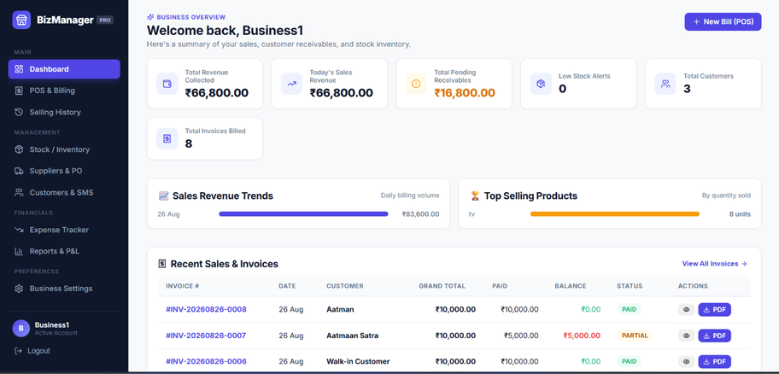
Introduction
  In modern retail, small and medium enterprises (SMEs) face intense competition requiring speed at the checkout counter and precise control over supply chain margins. Small business owners typically rely either on complex, expensive legacy software with steep learning curves or error-prone manual paper registers. BizManager bridges this digital divide by offering an intuitive, browser-based retail terminal that unifies inventory tracking, customer relationship management (CRM), point-of-sale invoicing, and real-time expense bookkeeping into a single unified interface.
3

Slide 4
Objectives
The primary objective of BizManager is to automate end-to-end retail business workflows while reducing operational friction at checkout.
(1) Enabling rapid multi-item billing with inclusive/exclusive GST auto- calculation
(2) Facilitating instant digital settlements via dynamic on-screen and printed UPI QR codes
(3) Automating inventory replenishment through integrated Purchase Orders and vendor ledgers
(4) Providing real-time financial transparency through automated Gross/Net Profit & Loss computation and GST tax summaries
  (5) Enhancing customer retention via 1-click native SMS communication.
4

Slide 5
Scope
Key Features
• POS & Billing – Generate multi-item bills with automatic GST calculation.
• Inventory Management – Track stock levels and update inventory after sales and purchases.
• Automated Restocking – Detect low-stock products and recommend reorder quantities.
• Supplier & Purchase Management – Manage suppliers, purchase orders and outstanding payables.
• Customer Management – Maintain customer records and purchase information.
Project Coverage
• Financial Management – Track revenue, expenses, profit/loss and GST summaries.
• Invoice Generation – Generate PDF invoices and thermal-print receipts.
• Digital Payments – Generate dynamic UPI QR codes for customer payments.
• Reports & Analytics – Provide sales, inventory and financial reports for decision-making.
• Data Portability – Support JSON data backup and CSV export for business records.
6

Slide 6
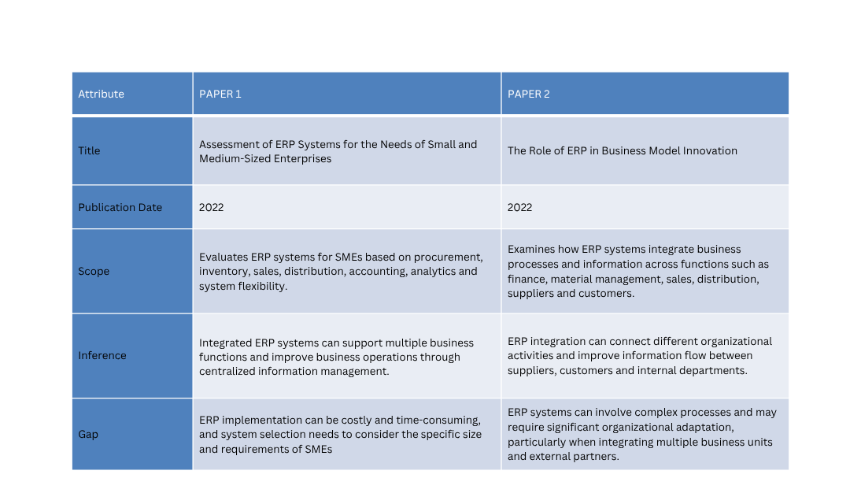
Literature Survey

Slide 7
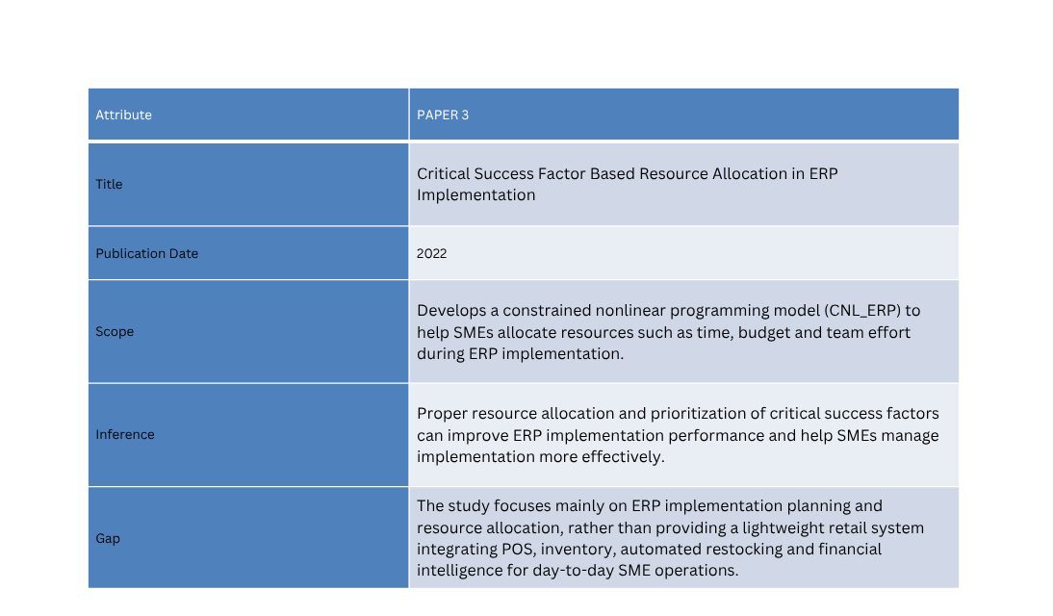
Literature Survey

Slide 8
Proposed System
System Users
•Business Owner: manages overall business operations, monitors sales, inventory, expenses and financial performance.
•Administrator: manages users, products, suppliers, customers and system settings.
•Sales Executive: creates bills, processes sales, generates invoices and records customer transactions.
• Inventory Manager: monitors stock levels, records purchases and manages low-stock products.
System Components
• Management Layer: customer, product, supplier, employee and business-profile management.
• Transaction Layer: POS billing, sales, purchases, GST calculation, invoice generation and payment recording.
• Inventory Layer: real-time stock updates, low-stock detection and automated restocking recommendations.
• Analytics Layer: sales reports, inventory reports, expenses, revenue and Profit & Loss analysis.
• Data Layer: centralized database with backup and CSV/JSON data export.
10

Slide 9
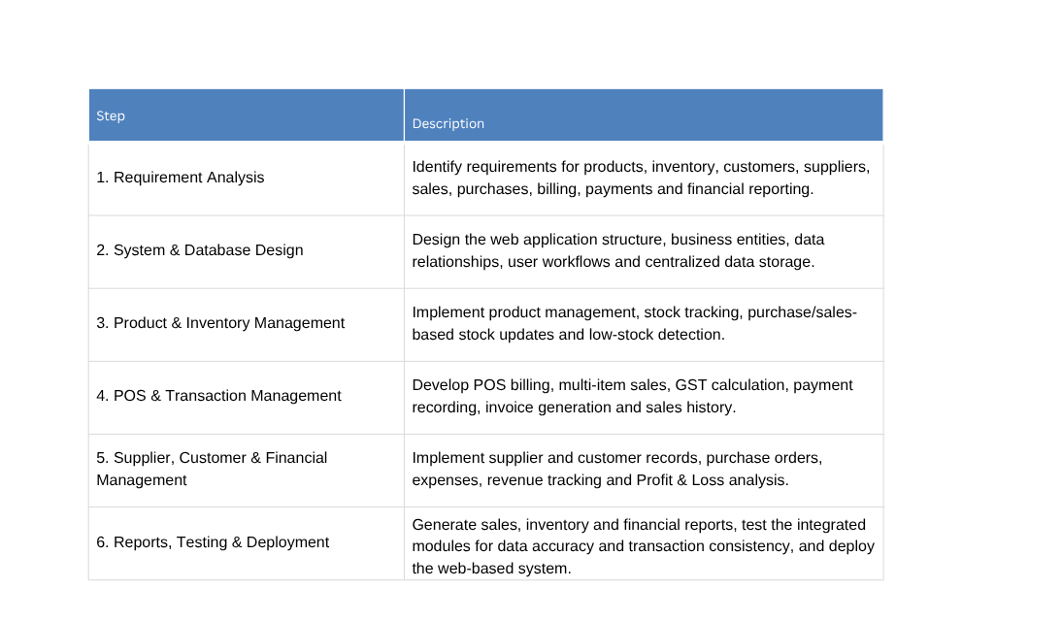
Methodology​
12

Slide 10
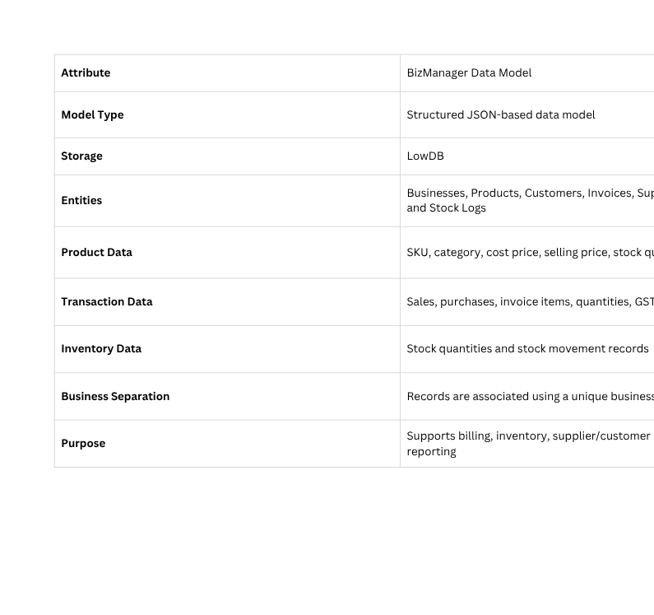
Data Model
13
12

Slide 11
Software & Hardware Requirements
Software Requirements
  Operating System: Windows 10/11, macOS or Linux
  Runtime Environment: Node.js (v18 or higher) & npm
  Frontend: React.js, Vite, Tailwind CSS
  Backend: Node.js & Express.js
  Database / Storage: LowDB with structured JSON data
  Development Tools: VS Code, Git/GitHub
  Browser: Google Chrome, Microsoft Edge or Mozilla Firefox
  Additional Libraries: Libraries for PDF invoice generation, QR-code generation and data export
Hardware Requirements
  Processor: Dual-Core CPU @ 2.0 GHz or higher
  RAM: Minimum 4 GB (8 GB recommended)
  Storage: 500 MB available disk space
  Display: 1366 × 768 resolution or higher
  Peripherals: Keyboard, mouse and optional POS thermal receipt printer / barcode scanner
14

Slide 12
Future Scope
  AI-Powered Demand Forecasting — Analyze historical sales data to predict product demand and generate more accurate reorder recommendations.
  Multi-Branch & Warehouse Management — Extend BizManager to manage and synchronize inventory and sales across multiple stores and warehouses.
  Cloud & Mobile Integration — Enable secure cloud-based data access and provide a mobile application for remote monitoring of sales, inventory and financial performance.
16

Slide 13
Conclusion
  BizManager successfully demonstrates a cloud-ready retail management system that integrates POS billing, inventory management, supplier and customer management, purchases, expenses, payments and financial reporting into a unified web application.
  The system automates stock updates and low-stock monitoring, reducing manual inventory tracking and supporting timely restocking decisions.
  Integrated GST billing, invoice generation, payment handling and sales history simplify day-to-day retail transactions.
  The financial intelligence and reporting modules provide insights into sales, revenue, expenses and Profit & Loss, helping business owners make data-driven decisions.
  Overall, BizManager provides a centralized, scalable and user-friendly platform for managing core retail operations efficiently.
15

Slide 14
References
  Ziemba, P., & Gago, I. (2022) – ERP systems for SMEs. Procedia Computer Science, 207, 3378–3386. DOI: 10.1016/j.procs.2022.09.397.
  Haddara, M., & Zach, O. (2012) – ERP Systems in SMEs: An Extended Literature Review.
  Botta-Genoulaz, V., Millet, P.-A., & Grabot, B. (2005) – Survey of ERP research literature.
  Malhotra, R., & Temponi, C. (2010) – ERP integration and small-business issues.
  Cebeci, U. (2009) – ERP selection using Fuzzy AHP.
17

